Slide 1
Git, GitHub, VS Code and Spike Python

Slide 2
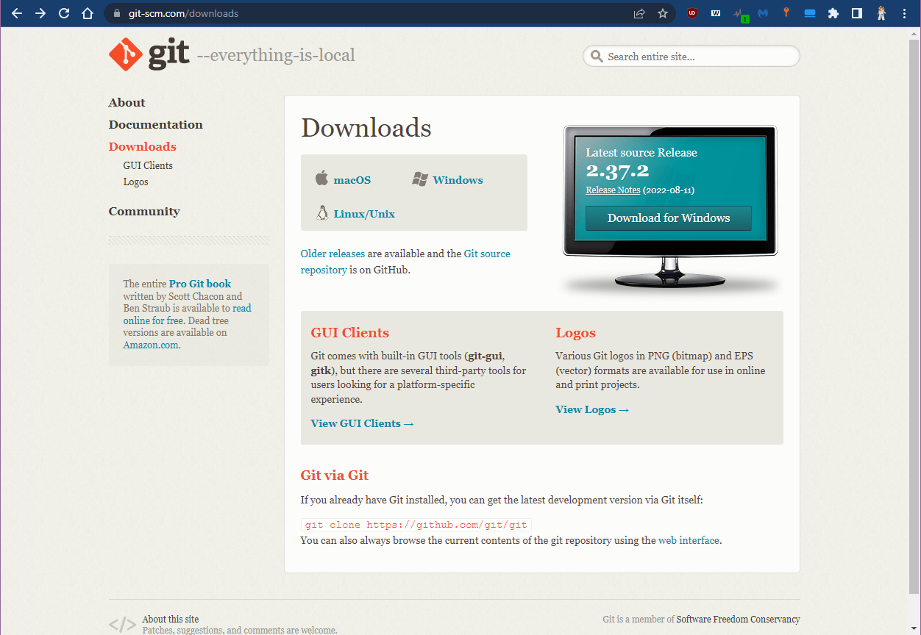
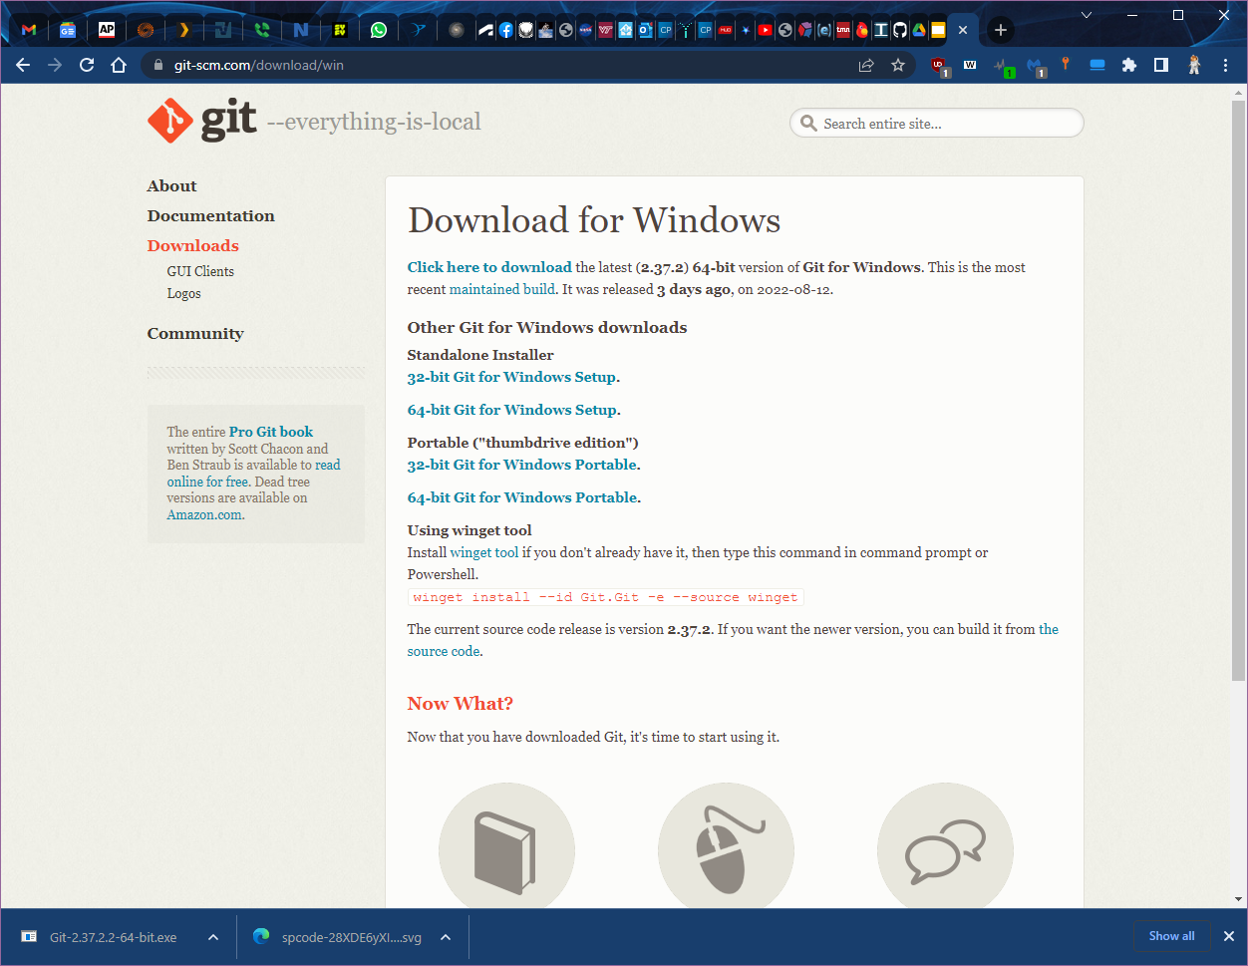
Download git for Windows
https://git-scm.com/downloads

Slide 3
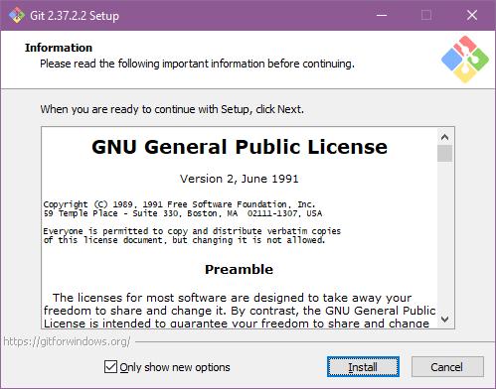
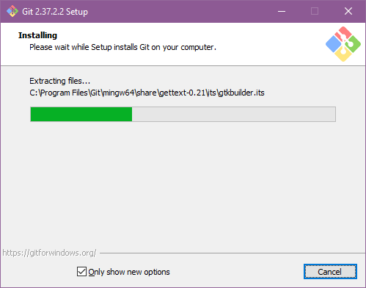
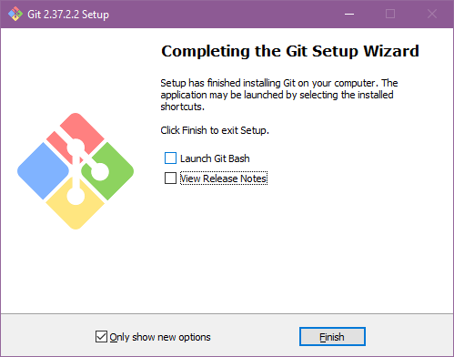
Install git
The first time you install git it will ask you a bunch of questions. Choosing the default pre-selected answer will do just fine for us here.

Slide 4
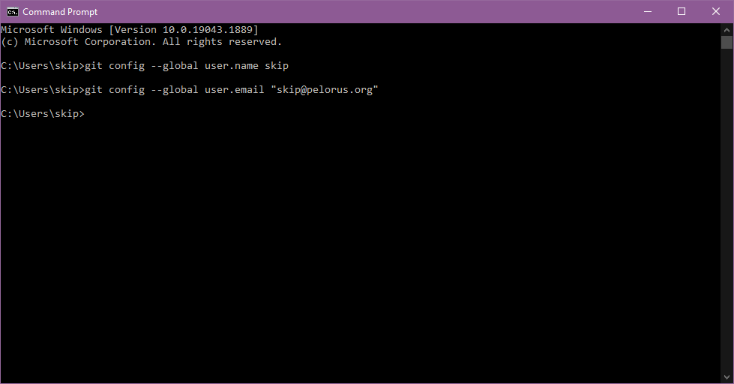
Set your git username and email
Open a command prompt by clicking on the Windows Start menu and then typing “cmd” and then press enter. Then enter these two commands.

Slide 5
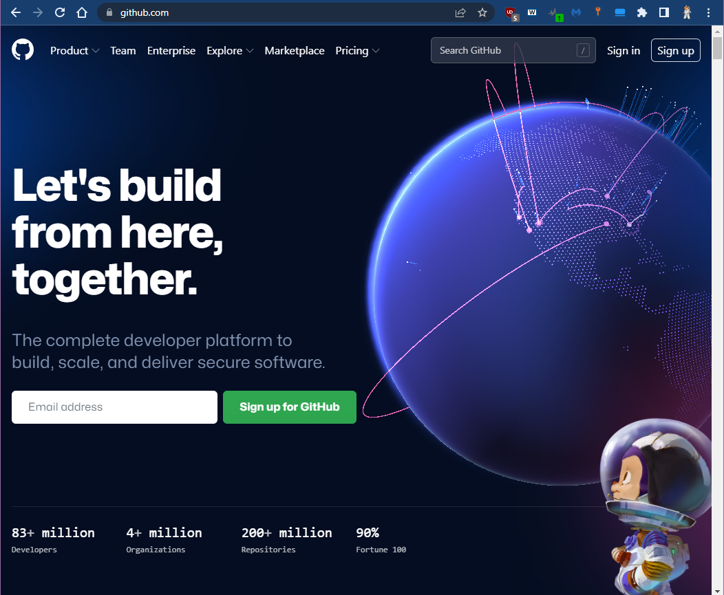
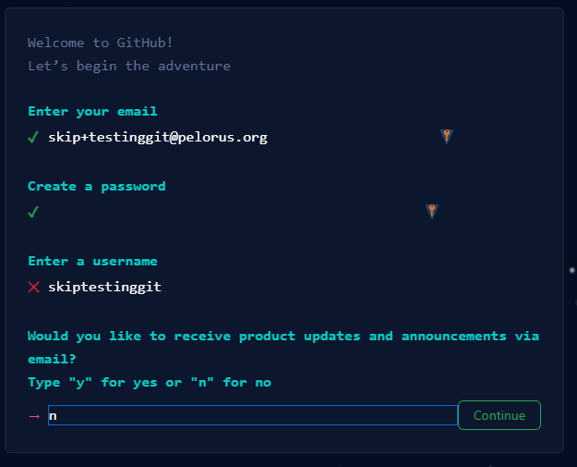
Create a free GitHub account
They will send a verification email to complete the setup, so be sure to use an email that you can access and one that is able to receive email from external sources (you may not be able to receive external email at your school account).
Solve the puzzle and they will send a code to that email.

Slide 6
Verify
Check your email for the code. Copy it (or memorize it if you have a great memory) and enter it in the validation screen

Slide 7
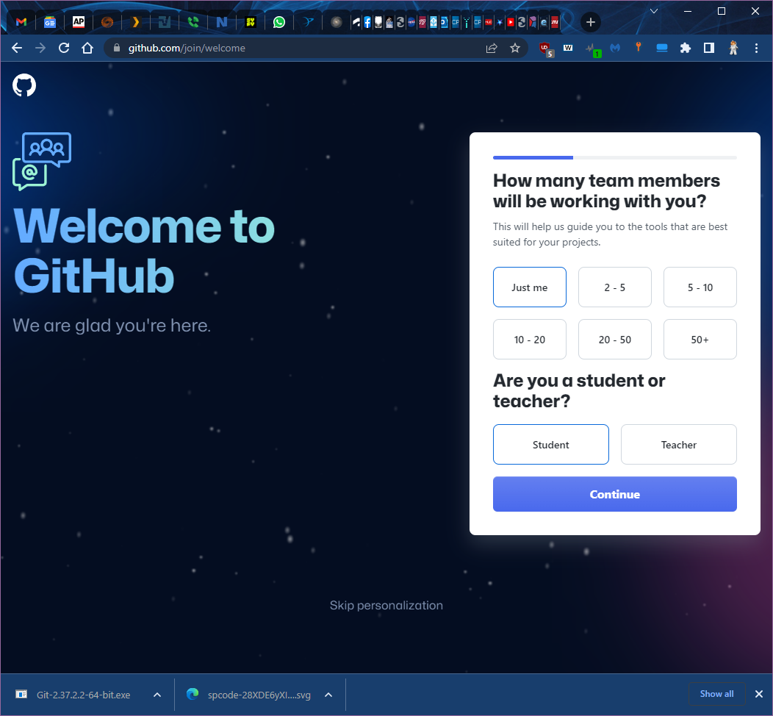
Welcome to GitHub!
Choose “Just me” and “Student”

Slide 8
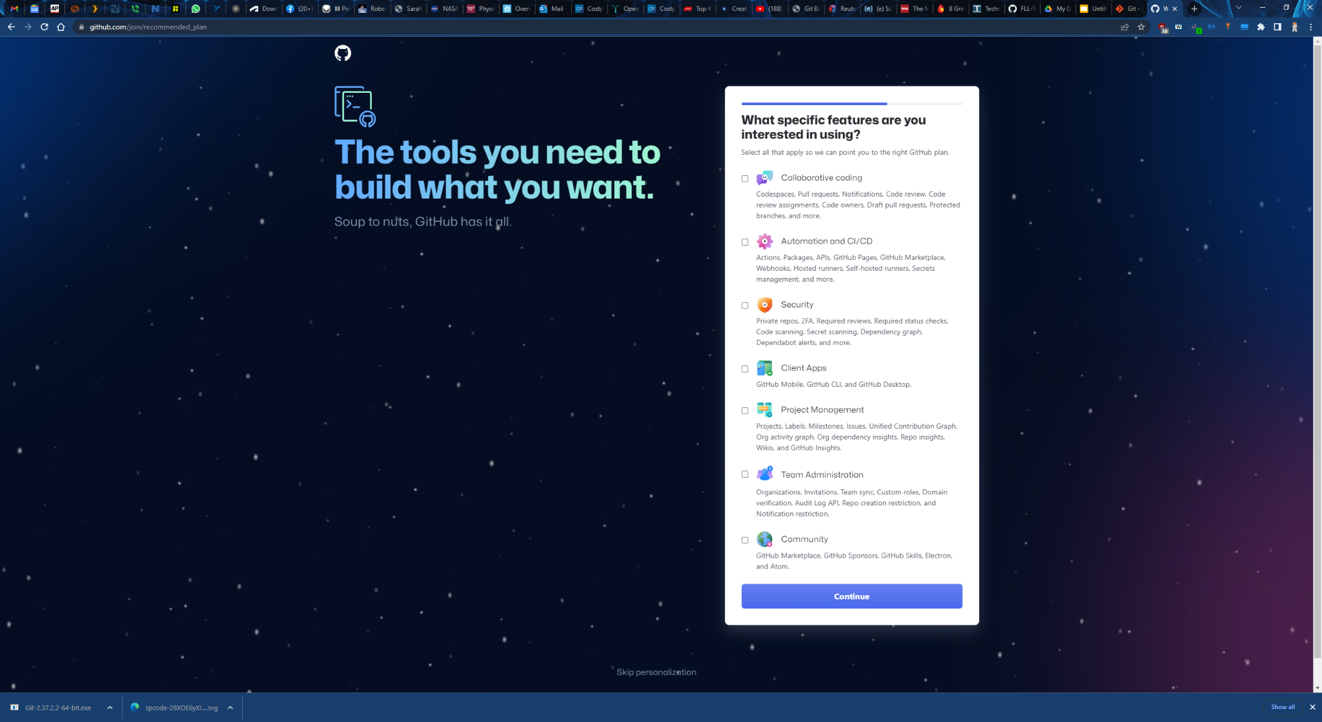
Select tools
No need to choose any of these tools for now. Someday you might want some of them. Many of these have added cost, so for now, just choose “Continue”.

Slide 9
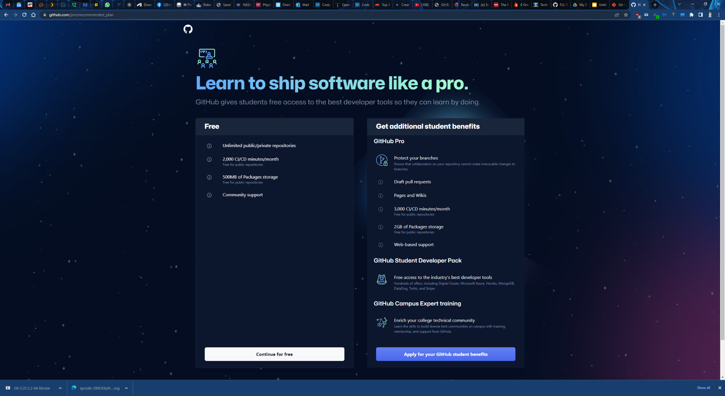
Choose your account type
For now, just choose “Continue for free”. Eventually you may want to apply for a student account, which will give you a lot of the pro benefits for free, but for now, just choose “Continue for free”.

Slide 10
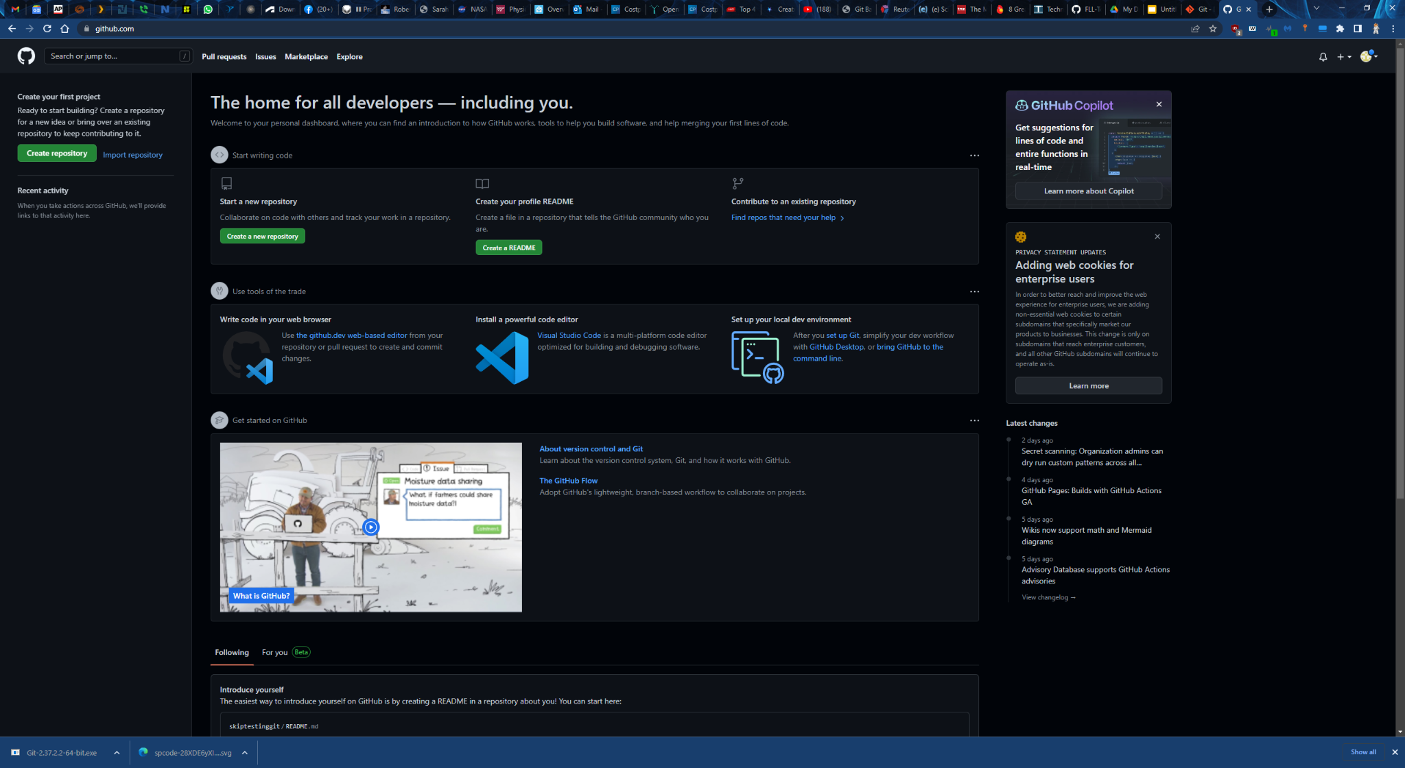
All done!

Slide 11
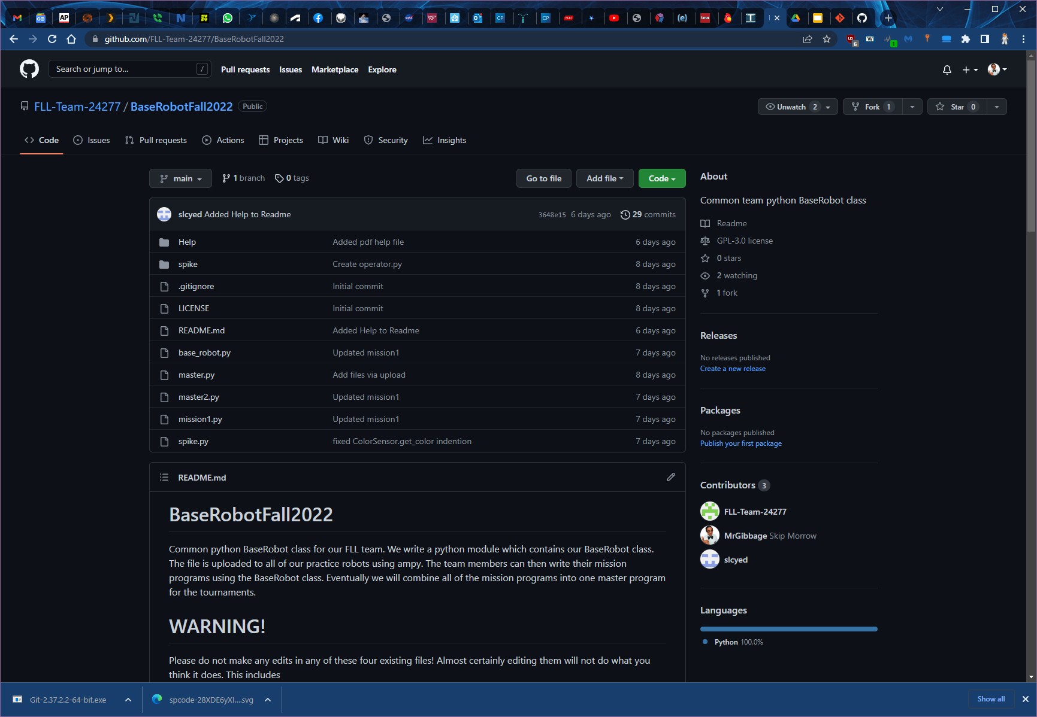
BaseRobotFall2022 Repository
Here is the GitHub page for the team’s Base Robot repository
https://github.com/FLL-Team-24277/BaseRobotFall2022
Leave this page open because you will need it when we clone the repository in a few more steps.

Slide 12
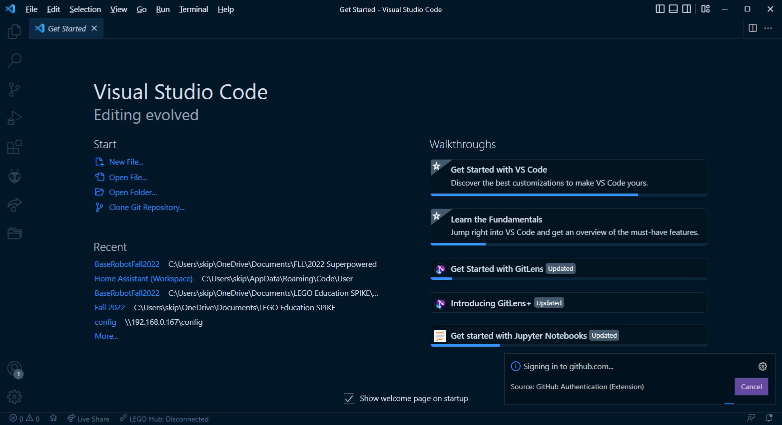
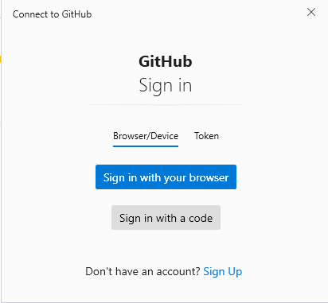
Open VS Code and add your GitHub account
Choose “Sign in with browser”

Slide 13
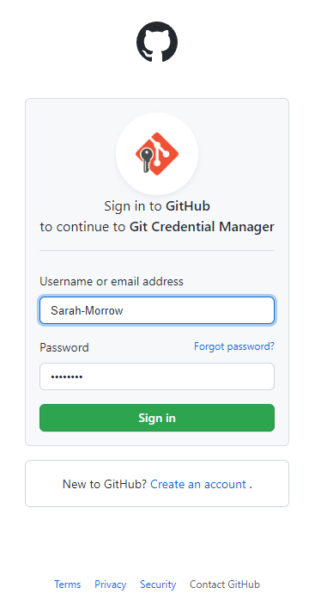
Sign in to GitHub
These next few screenshots were from my daughter’s account. Please just use your username and password.

Slide 14
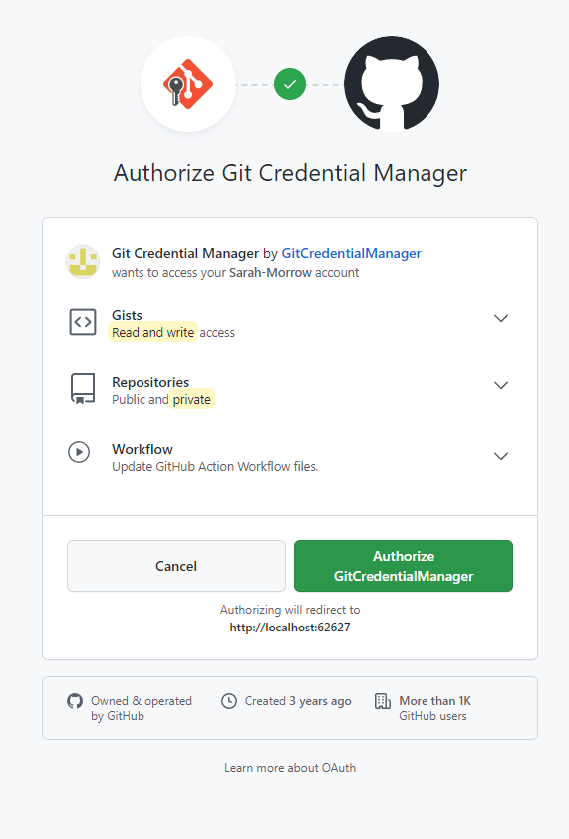
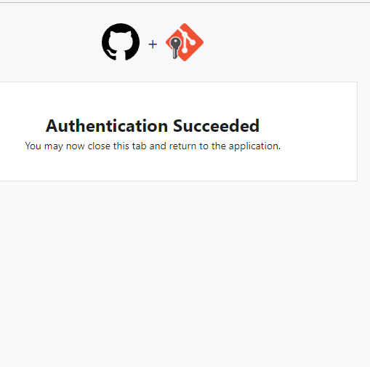
Authorize Git Credential Manager

Slide 15
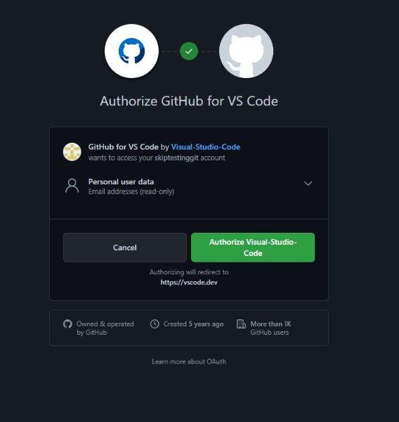
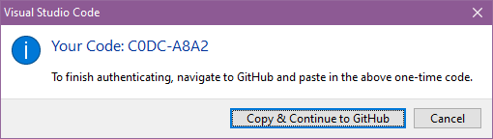
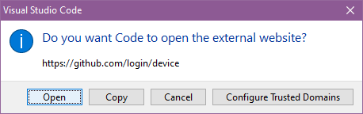
Authorize GitHub for VS Code
Choose “Copy and Continue” and the “Open”. Your code should be copied to the clipboard

Slide 16
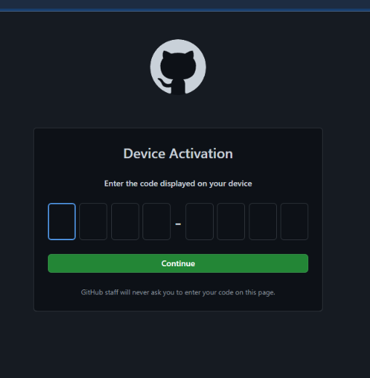
Enter the code
You should be able to press ctrl-v to paste in the code.

Slide 17
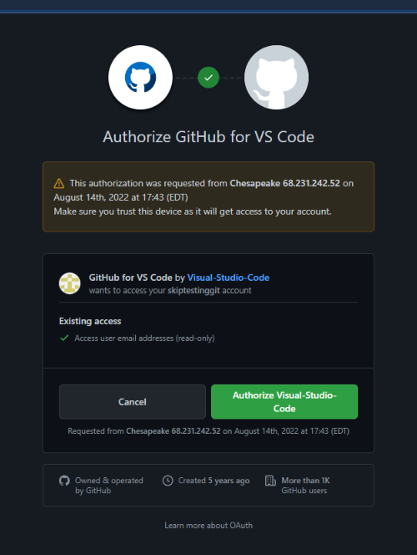
Authorize GitHub for VS Code

Slide 18
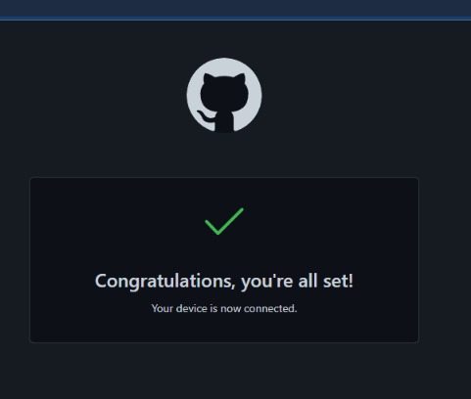
All set!

Slide 19
Clone a repository
Cloning a repository takes a copy of a repository (or repo) from GitHub and puts it on your computer. You can then edit the code as you wish, and then when you are ready, you can push your changes (or no changes at all) to YOUR github account.
Having your code on GitHub gives you a lot of advantages, such as version control and the added security of having your code online and not just residing on one laptop.
Go back to the github page with the BaseRobot repo. Here’s the link in case you closed it:
https://github.com/FLL-Team-24277/BaseRobotFall2022

Slide 20
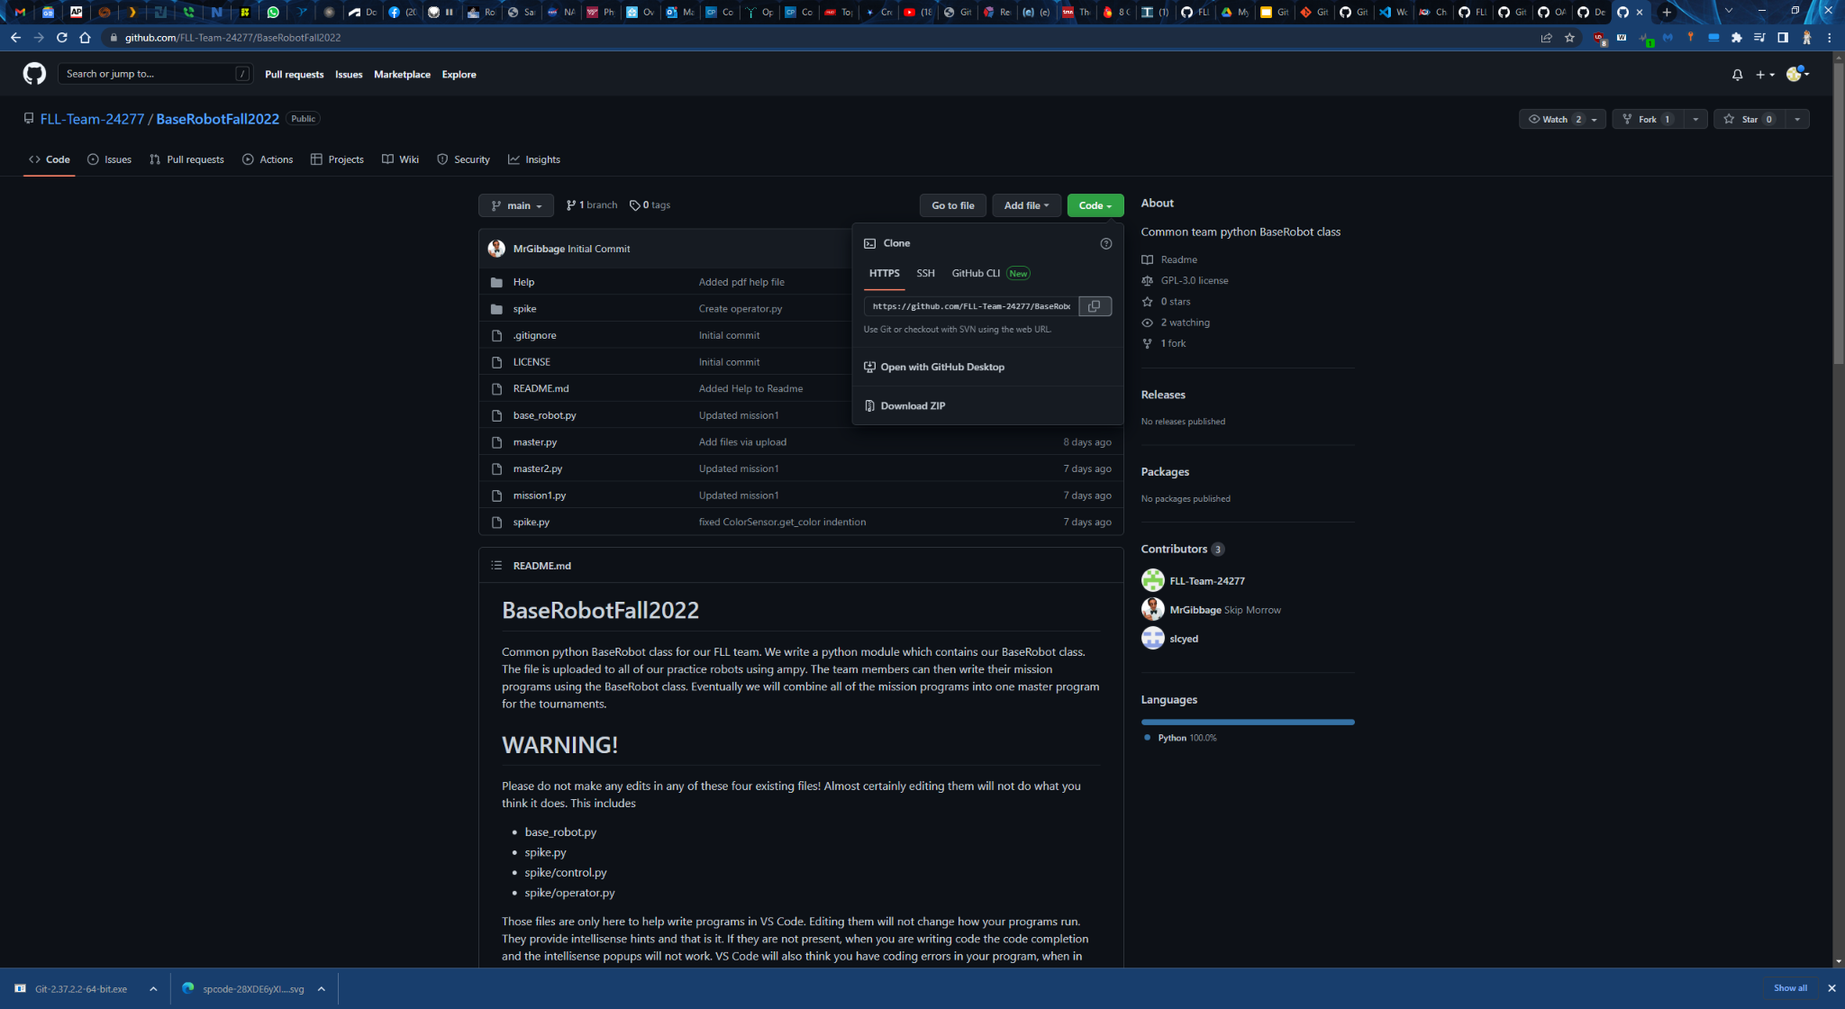
Get the link to the repo
Click the green “Code” button, and then click on the icon to copy the link

Slide 21
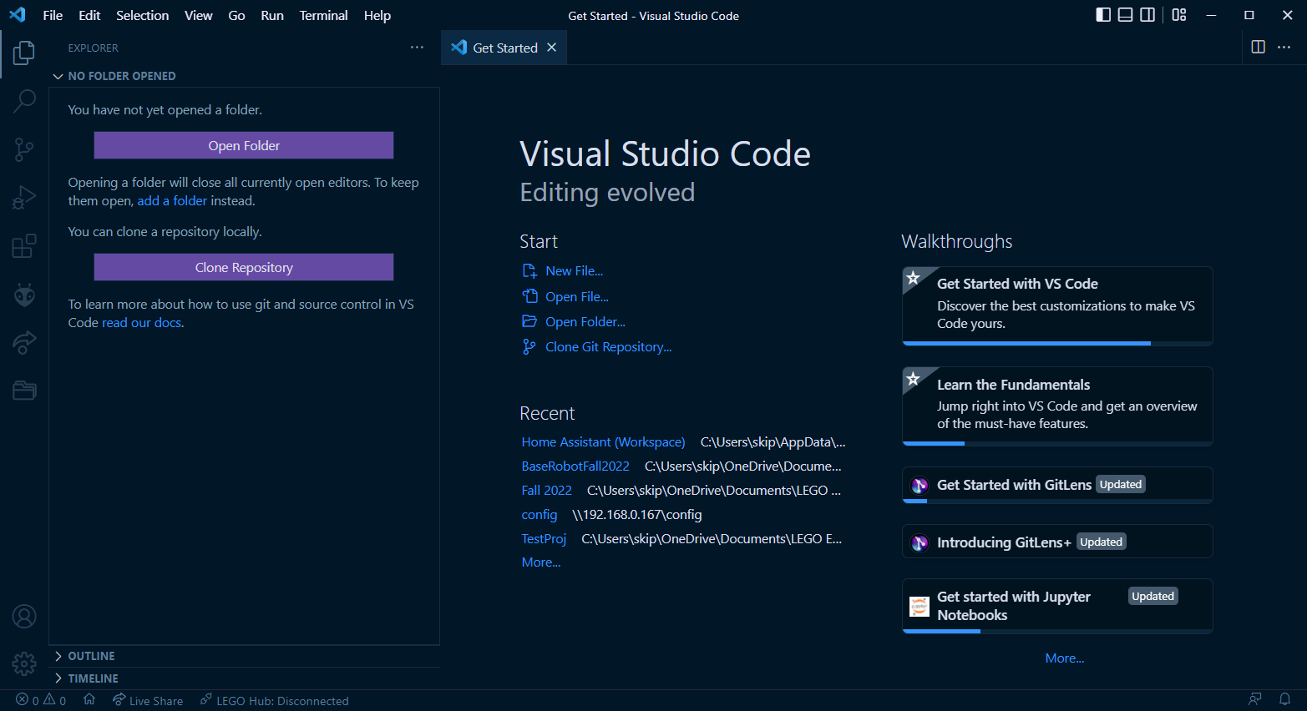
Back to VS Code

Slide 22
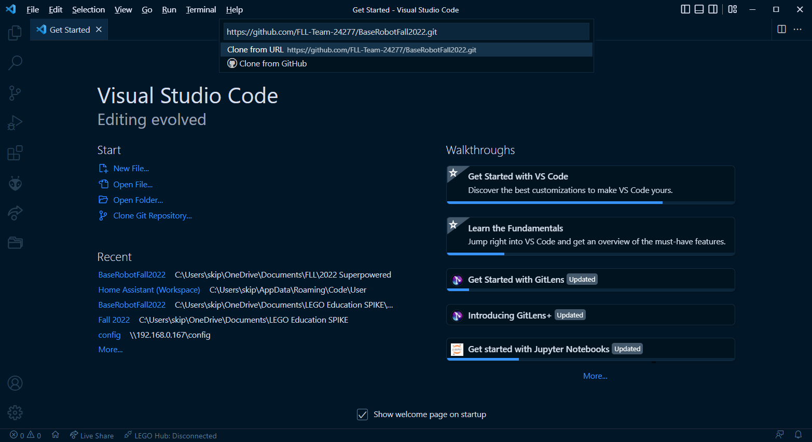
Clone the BaseRobot Repo
Paste in the link to the repo

Slide 23
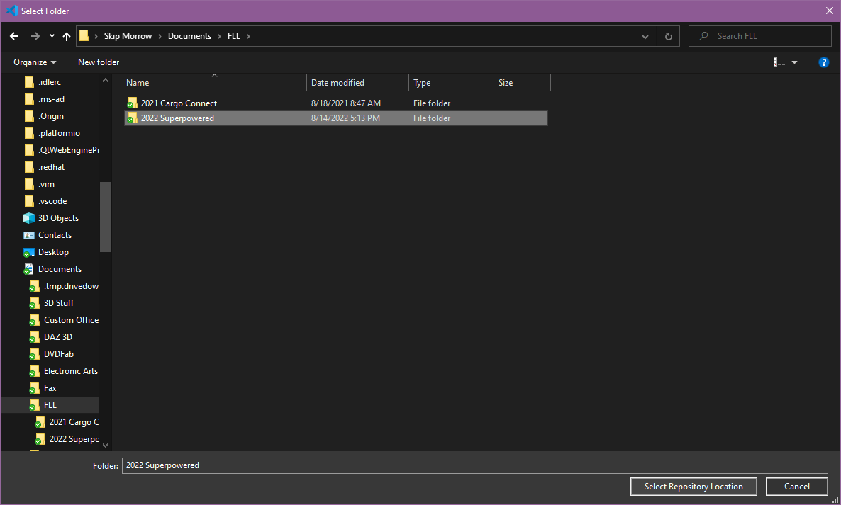
Select the local location
Here I have selected a folder for the 2022 Superpowered season. You may have your folders set up differently. You may need to click the “New Folder” button if you don’t already have a good place to put your program.

Slide 24
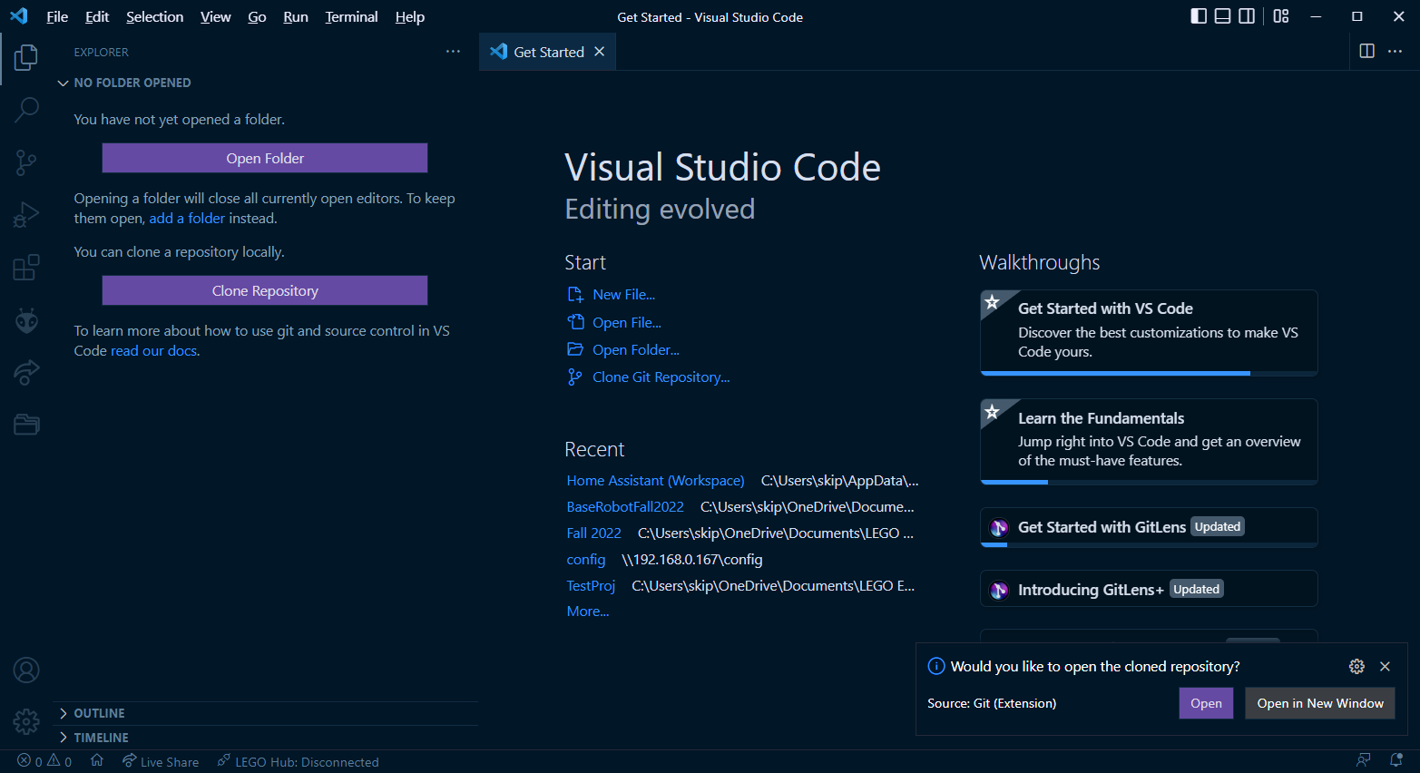
Open the cloned repo
Watch down here while it is importing and then open it.

Slide 25
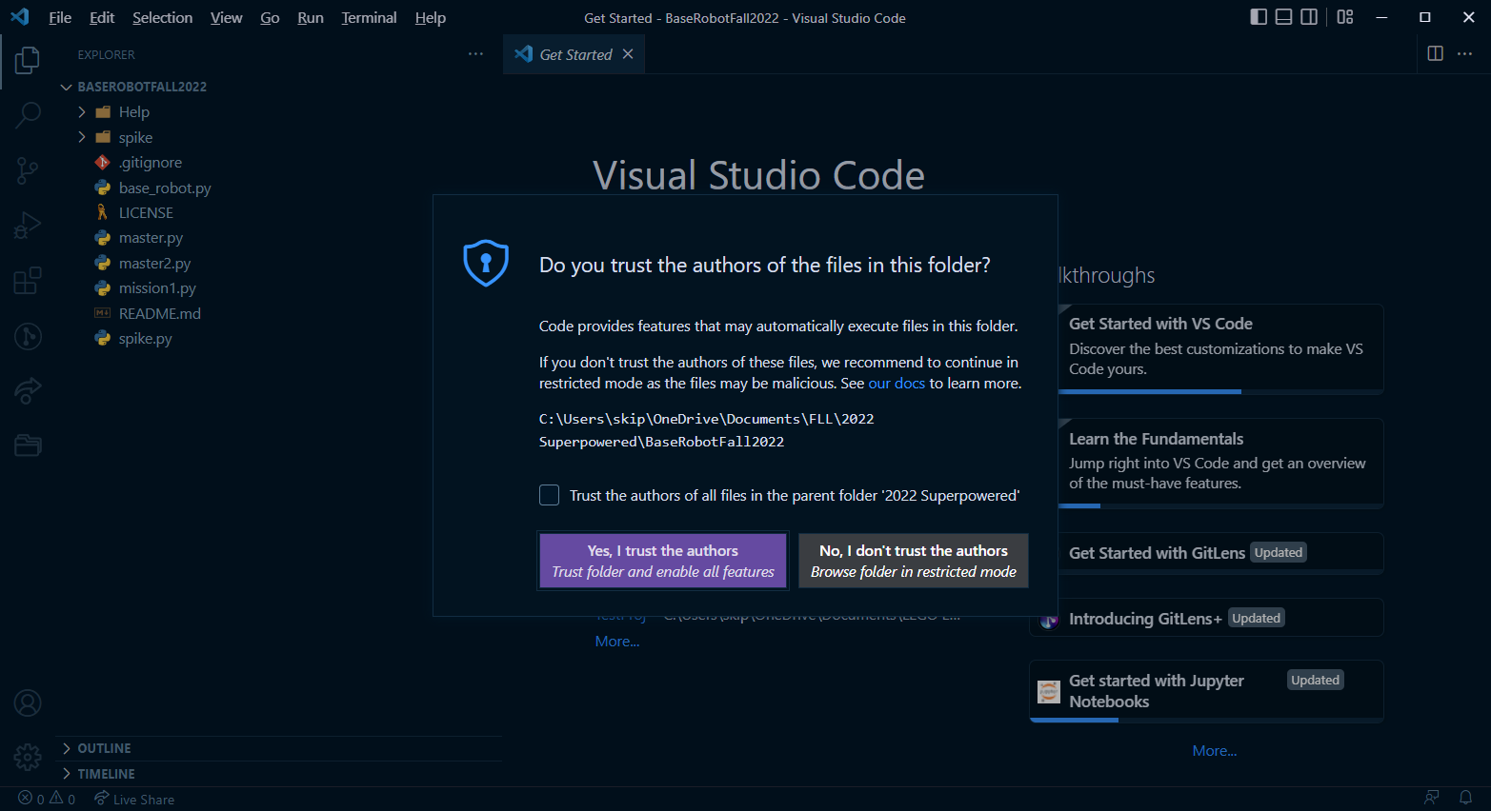
Trust the repo authors

Slide 26
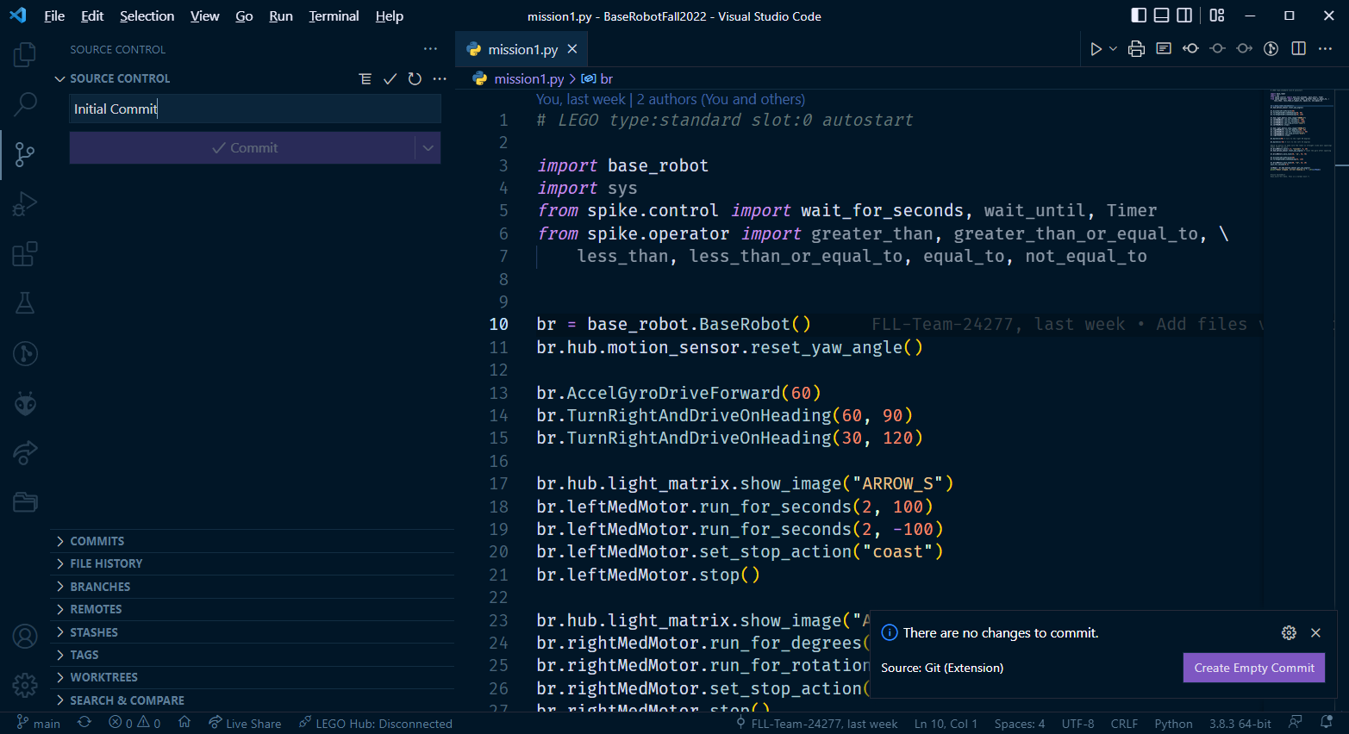
Push the local copy to a new repo in your GitHub account

Slide 27
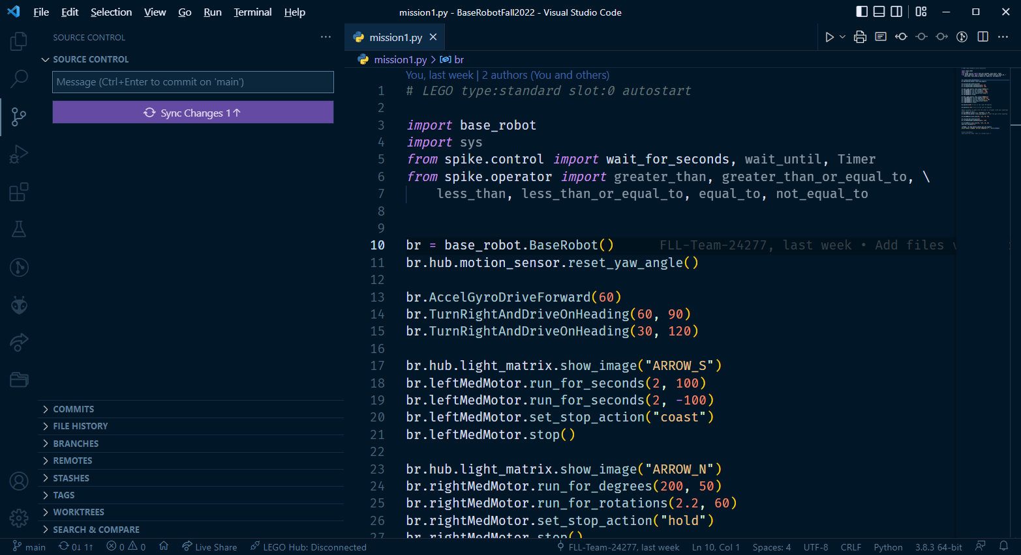
Sync Changes
This will upload your workspace to your account on GitHub.

Slide 28
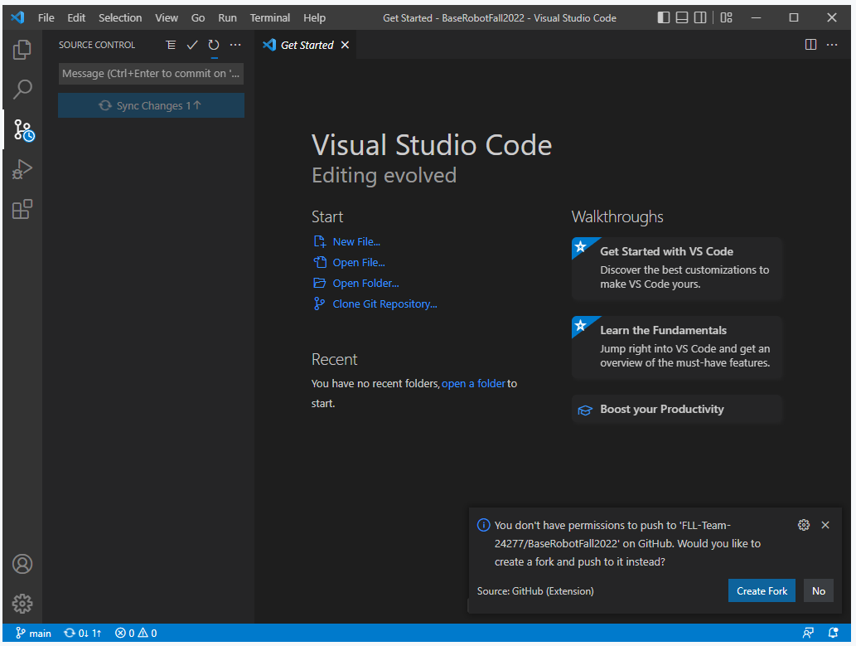
Create a fork and push to YOUR repo
You don’t have permission to push any code to the repo where you got the code, so VS Code is asking if you want to create a fork and push your code to YOUR repo instead. You only have to do this once. There may be a few more authorization screens. Just approve everything.

Slide 29
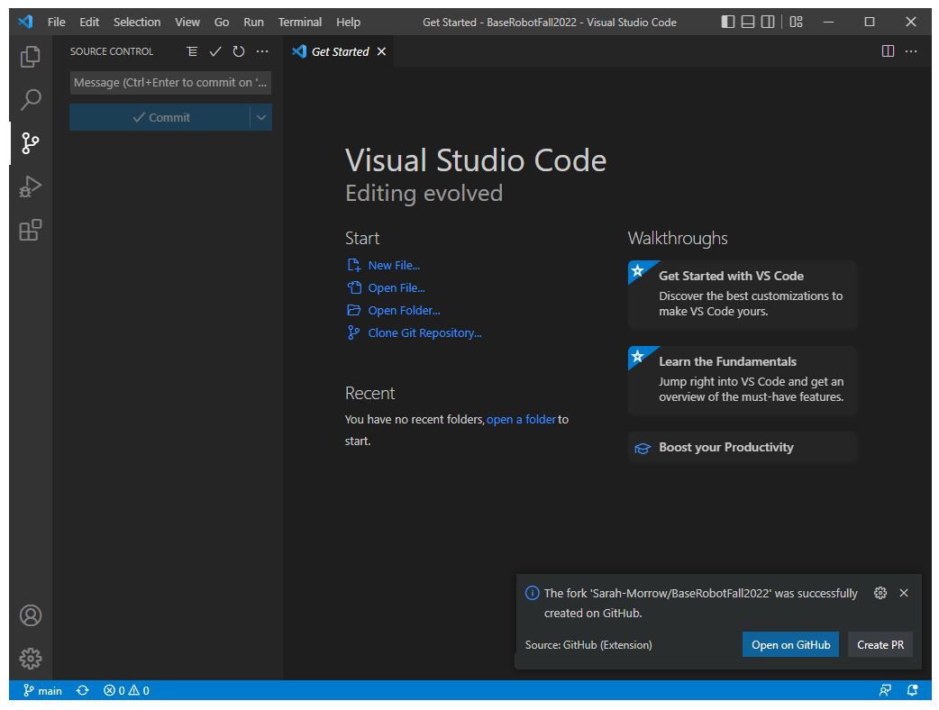
Your repo has been created
From now on you will be able to push any updates to GitHub. And if you ever need to get your code back to an earlier version, or if you need to get a backup of your code, it will be available on GitHub.
You can click this button to see that your code has been uploaded to GitHub.

Slide 30
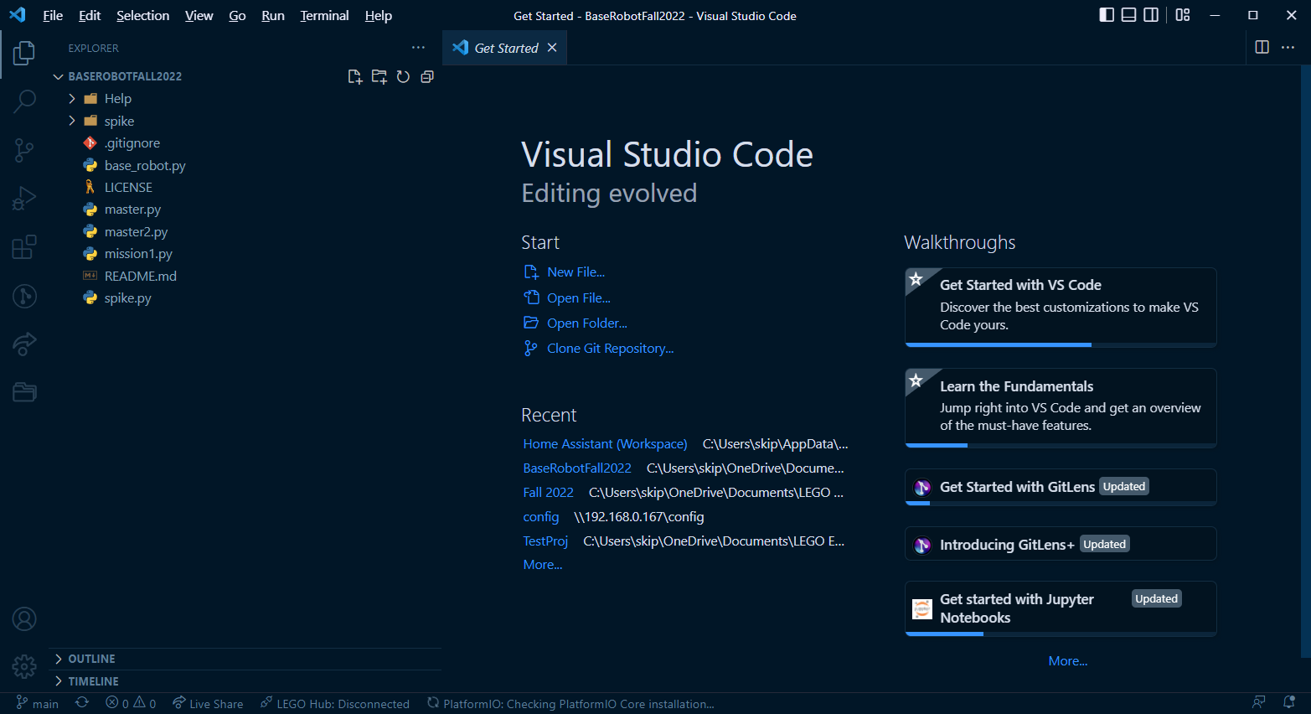
Your local copy of the repo
This is your LOCAL copy of the repo. Any changes you make are your own changes and do not affect the repo where you got the code. The next tutorial will show how to make changes to your code and push them to GitHub.

Slide 31
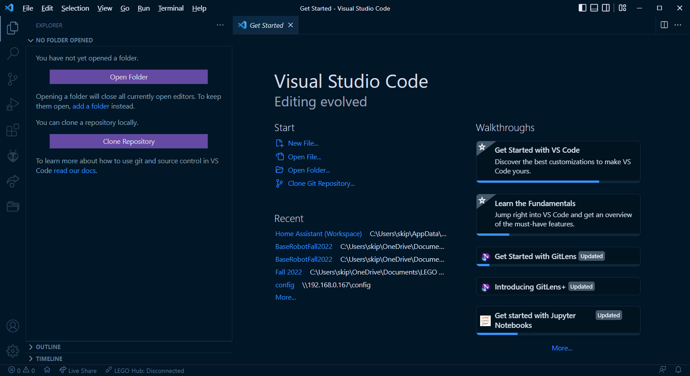
What to do if your workspace isn’t showing
Just click on “Open Folder” and then browse to where you saved your local repo copy.

